Slide 1
Shortest path algorithms
Three different algorithms:
Minimum spanning tree:
Prim’s
Kruskal’s
Dijkstra’s algorithm

Slide 2
Minimum Spanning Trees
A spanning tree of a connected, undirected graph G is a sub-graph of G which is a tree that connects all the vertices together
A graph G can have many different spanning trees.
We can assign weights to each edge, and use it to assign a weight to a spanning tree by calculating the sum of the weights of the edges in that spanning tree
A minimum spanning tree (MST) is defined as a spanning tree with weight less than or equal to the weight of every other spanning tree.

Slide 3
An Analogy
Take an analogy of a cable TV company laying cable in a new neighborhood. If it is restricted to bury the cable only along particular paths, then we can make a graph that represents the points that are connected by those paths. Some paths may be more expensive (due to their length or the depth at which the cable should be buried) than the others. We can represent these paths by edges with larger weights.
Therefore, a spanning tree for such a graph would be a subset of those paths that has no cycles but still connects to every house. Many distinct spanning trees can be obtained from this graph, but a minimum spanning tree would be the one with the lowest total cost.

Slide 4
Properties
Possible multiplicity There can be multiple minimum spanning trees of the same weight. Particularly, if all the weights are the same, then every spanning tree will be minimum.
Uniqueness When each edge in the graph is assigned a different weight, then there will be only one unique minimum spanning tree.

Slide 5
Properties
Minimum-cost subgraph If the edges of a graph are assigned non-negative weights, then a minimum spanning tree is in fact the minimum-cost subgraph or a tree that connects all vertices.

Slide 6
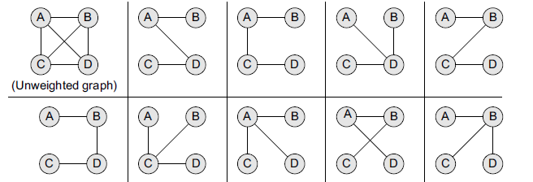
MST for unweighted Graph
Consider an unweighted graph G given below From G, we can draw many distinct spanning trees. Eight of them are given here. For an unweighted graph, every spanning tree is a minimum spanning tree.

Slide 7
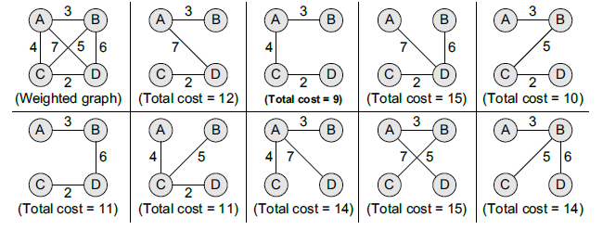
MST for weighted Graph
Consider an weighted graph G given below From G.

Slide 8
Applications of MST
For designing networks - For instance, people separated by varying distances wish to be connected together through a telephone network. A minimum spanning tree is used to determine the least costly paths with no cycles in this network, thereby providing a connection that has the minimum cost involved.
To find airline routes - While the vertices in the graph denote cities, edges represent the routes between these cities. No doubt, more the distance between the cities, higher will be the amount charged. Therefore, MSTs are used to optimize airline routes by finding the least costly path with no cycles.
MSTs are applied in routing algorithms for finding the most efficient path.

Slide 9
Prim’s algorithm
Greedy algorithm – used to form a minimum spanning tree for a connected weighted graph.
Builds a tree that includes every vertex and a subset of the edges in such a way that the total weight of all the edges in the tree is minimized.

Slide 10
Prim’s algorithm
The algorithm maintains three sets of vertices which can be given as below:
Tree vertices Vertices that are a part of the minimum spanning tree T.
Fringe vertices Vertices that are currently not a part of T, but are adjacent to some tree vertex.
Unseen vertices Vertices that are neither tree vertices nor fringe vertices fall under this category.

Slide 11
Prim’s algorithm
Step 1: Select a starting vertex
Step 2: Repeat Steps 3 and 4 until there are fringe vertices
Step 3: Select an edge e connecting the tree vertex and fringe vertex that has minimum weight
Step 4: Add the selected edge and the vertex to the minimum spanning tree T
[END OF LOOP]
Step 5: EXIT

Slide 13
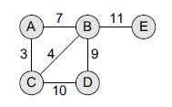
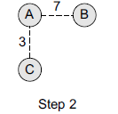
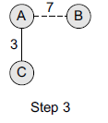
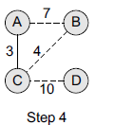

Prim’s algorithm – constructing MST
Step 3: Select an edge connecting the tree vertex and the fringe vertex that has the minimum weight and add the selected edge and the vertex to the minimum spanning tree T. Since the edge connecting A and C has less weight, add C to the tree. Now C is not a fringe vertex but a tree vertex.
Step 1: Choose a starting vertex A.
Step 2: Add the fringe vertices (that are adjacent to A). The edges connecting the vertex and fringe vertices are shown with dotted lines.
Step 4: Add the fringe vertices (that are adjacent to C).

Slide 14
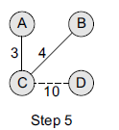
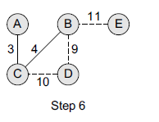
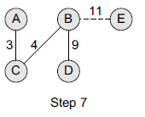
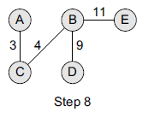
Prim’s algorithm – constructing MST
Step 5: Select an edge connecting the tree vertex and the fringe vertex that has the minimum weight and add the selected edge and the vertex to the minimum spanning tree T. Since the edge connecting C and B has less weight, add B to the tree. Now B is not a fringe vertex but a tree vertex.
Step 6: Add the fringe vertices (that are adjacent to B).
Step 7: Select an edge connecting the tree vertex and the fringe vertex that has the minimum weight and add the selected edge and the vertex to the minimum spanning tree T. Since the edge connecting B and D has less weight, add D to the tree. Now D is not a fringe vertex but a tree vertex.
Step 8: now node E is not connected, add it in the tree because a minimum spanning tree is one in which all the n nodes are connected with n–1 edges that have minimum weight.

Slide 15
Difference between Prim’s and Kruskal’s algorithm
Prim’s Algorithm | Kruskal’s Algorithm
Greedy algorithm for finding minimum spanning tree | Greedy algorithm for finding minimum spanning tree
Starting with a single vertex, you always keep connected component. At every next step look at all edges from the current component to other vertices and find the smallest among them. | Do not keep one connected component but a forest. At each stage, look at globally smallest edge that does not create a cycle in the current forest.

Slide 16
Kruskal’s algorithm
To find minimum spanning tree for a connected weighted graph.
The algorithm finds a subset of the edges that forms a tree that includes every vertex.
The total weight of all the edges in the tree is minimized.
Uses priority queue in which edges that have minimum weight takes a priority over any other edge in the graph.

Slide 17
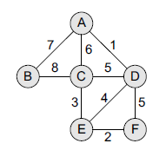
Applying Kruskal’s algorithm
Initially we have, F – Forest,
MST = { } →empty initially
Q = priority queue
Based on graph given,
F={{A},{B},{C},{D},{E},{F}}
MST = { }
Q= {(A,D),(E,F),(C,E),(E,D),(C,D),(D,F),(A,C),(A,B),(B,C))

Slide 18
Applying Kruskal’s algorithm
Based on graph given,
F={{A},{B},{C},{D},{E},{F}}
MST = { }
Q= {(A,D),(E,F),(C,E),(E,D),(C,D),(D,F),(A,C),(A,B),(B,C))
Step 1: Remove the edge (A, D) from Q and make the following changes:
F = {{A, D}, {B}, {C}, {E}, {F}}
MST = {A, D}
Q = {(E, F), (C, E), (E, D), (C, D), (D, F), (A, C), (A, B), (B, C)}

Slide 19
Applying Kruskal’s algorithm
Step 1: Remove the edge (A, D) from Q and make the following changes:
F = {{A, D}, {B}, {C}, {E}, {F}}
MST = {A, D}
Q = {(E, F), (C, E), (E, D), (C, D), (D, F), (A, C), (A, B), (B, C)}
Step 2: Remove the edge (E, F) from Q and make the following changes:
F = {{A, D}, {B}, {C}, {E, F}}
MST = {(A, D), (E, F)}
Q = {(C, E), (E, D), (C, D), (D, F), (A, C), (A, B), (B, C)}

Slide 20
Applying Kruskal’s algorithm
Step 2: Remove the edge (E, F) from Q and make the following changes:
F = {{A, D}, {B}, {C}, {E, F}}
MST = {(A, D), (E, F)}
Q = {(C, E), (E, D), (C, D), (D, F), (A, C), (A, B), (B, C)}
Step 3: Remove the edge (C, E) from Q and make the following changes:
F = {{A, D}, {B}, {C, E, F}}
MST = {(A, D), (C, E), (E, F)}
Q = {(E, D), (C, D), (D, F), (A, C), (A, B), (B, C)}

Slide 21
Applying Kruskal’s algorithm
Step 3: Remove the edge (C, E) from Q and make the following changes:
F = {{A, D}, {B}, {C, E, F}}
MST = {(A, D), (C, E), (E, F)}
Q = {(E, D), (C, D), (D, F), (A, C), (A, B), (B, C)}
Step 4: Remove the edge (E, D) from Q and make the following changes:
F = {{A, C, D, E, F}, {B}}
MST = {(A, D), (C, E), (E, F), (E, D)}
Q = {(C, D), (D, F), (A, C), (A, B), (B, C)}

Slide 22
Applying Kruskal’s algorithm
Step 4: Remove the edge (E, D) from Q and make the following changes:
F = {{A, C, D, E, F}, {B}}
MST = {(A, D), (C, E), (E, F), (E, D)}
Q = {(C, D), (D, F), (A, C), (A, B), (B, C)}
Step 5: Remove the edge (C, D) from Q. Note that this edge does not connect different trees, so simply discard this edge. Only an edge connecting (A, D, C, E, F) to B will be added to the MST. Therefore,
F = {{A, C, D, E, F}, {B}}
MST = {(A, D), (C, E), (E, F), (E, D)}
Q = {(D, F), (A, C), (A, B), (B, C)}

Slide 23
Applying Kruskal’s algorithm
Step 5: Remove the edge (C, D) from Q. Note that this edge does not connect different trees, so simply discard this edge. Only an edge connecting (A, D, C, E, F) to B will be added to the MST. Therefore,
F = {{A, C, D, E, F}, {B}}
MST = {(A, D), (C, E), (E, F), (E, D)}
Q = {(D, F), (A, C), (A, B), (B, C)}
Step 6: Remove the edge (D, F) from Q. Note that this edge does not connect different trees, so simply discard this edge. Only an edge connecting (A, D, C, E, F) to B will be added to the MST.
F = {{A, C, D, E, F}, {B}}
MST = {(A, D), (C, E), (E, F), (E, D)}
Q = {(A, C), (A, B), (B, C)}

Slide 24
Applying Kruskal’s algorithm
Step 6: Remove the edge (D, F) from Q. Note that this edge does not connect different trees, so simply discard this edge. Only an edge connecting (A, D, C, E, F) to B will be added to the MST.
F = {{A, C, D, E, F}, {B}}
MST = {(A, D), (C, E), (E, F), (E, D)}
Q = {(A, C), (A, B), (B, C)}
Step 7: Remove the edge (A, C) from Q. Note that this edge does not connect different trees, so simply discard this edge. Only an edge connecting (A, D, C, E, F) to B will be added to the MST.
F = {{A, C, D, E, F}, {B}}
MST = {(A, D), (C, E), (E, F), (E, D)}
Q = {(A, B), (B, C)}

Slide 25
Applying Kruskal’s algorithm
Step 7: Remove the edge (A, C) from Q. Note that this edge does not connect different trees, so simply discard this edge. Only an edge connecting (A, D, C, E, F) to B will be added to the MST.
F = {{A, C, D, E, F}, {B}}
MST = {(A, D), (C, E), (E, F), (E, D)}
Q = {(A, B), (B, C)}
Step 8: Remove the edge (A, B) from Q and make the following changes:
F = {A, B, C, D, E, F}
MST = {(A, D), (C, E), (E, F), (E, D), (A, B)}
Q = {(B, C)}

Slide 27
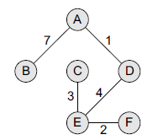
Applying Kruskal’s algorithm
Step 8: Remove the edge (A, B) from Q and make the following changes:
F = {A, B, C, D, E, F}
MST = {(A, D), (C, E), (E, F), (E, D), (A, B)}
Q = {(B, C)}
Step 9: The algorithm continues until Q is empty. Since the entire forest has become one tree, all the remaining edges will simply be discarded.
F = {A, B, C, D, E, F}
MST = {(A, D), (C, E), (E, F), (E, D), (A, B)}
Q = {}

Slide 28
A cable company want to connect five villages to their network which currently extends to the market town of Avonford. What is the minimum length of cable needed?
Example
Brinleigh
5
Cornwell
3
4
8
6
8
Avonford
Fingley
Donster
7
5
4
2
Edan

Slide 29
We model the situation as a network, then the problem is to find the minimum connector for the network
B
5
C
3
4
8
6
8
A
F
D
7
5
4
2
E

Slide 30
Kruskal’s Algorithm
List the edges in order of size:
ED 2
AB 3
AE 4
CD 4
BC 5
EF 5
CF 6
AF 7
BF 8
CF 8
B
5
C
3
4
8
6
8
A
D
7
F
5
4
2
E

Slide 31
Kruskal’s Algorithm
Select the shortest
edge in the network
ED 2
B
5
C
3
4
8
6
8
A
D
7
F
5
4
2
E

Slide 32
Kruskal’s Algorithm
Select the next shortest
edge which does not
create a cycle
ED 2
AB 3
B
5
C
3
4
8
6
8
A
D
7
F
5
4
2
E

Slide 33
Kruskal’s Algorithm
Select the next shortest
edge which does not
create a cycle
ED 2
AB 3
CD 4 (or AE 4)
B
5
C
3
4
8
6
8
A
D
7
F
5
4
2
E

Slide 34
Kruskal’s Algorithm
Select the next shortest
edge which does not
create a cycle
ED 2
AB 3
CD 4
AE 4
B
5
C
3
4
8
6
8
A
D
7
F
5
4
2
E

Slide 35
Kruskal’s Algorithm
Select the next shortest
edge which does not
create a cycle
ED 2
AB 3
CD 4
AE 4
BC 5 – forms a cycle
EF 5
B
5
C
3
4
8
6
8
A
D
7
F
5
4
2
E

Slide 36
Kruskal’s Algorithm
All vertices have been
connected.
The solution is
ED 2
AB 3
CD 4
AE 4
EF 5
Total weight of tree: 18
B
5
C
3
4
8
6
8
A
D
7
F
5
4
2
E

Slide 37
Prim’s Algorithm
Select any vertex
A
Select the shortest edge connected to that vertex
AB 3
B
5
C
3
4
8
6
8
A
D
7
F
5
4
2
E

Slide 38
Prim’s Algorithm
Select the shortest
edge connected to
any vertex already
connected.
AE 4
B
5
C
3
4
8
6
8
A
D
7
F
5
4
2
E

Slide 39
Prim’s Algorithm
Select the shortest
edge connected to
any vertex already
connected.
ED 2
B
5
C
3
4
8
6
8
A
D
7
F
5
4
2
E

Slide 40
Prim’s Algorithm
Select the shortest
edge connected to
any vertex already
connected.
DC 4
B
5
C
3
4
8
6
8
A
D
7
F
5
4
2
E

Slide 41
Prim’s Algorithm
Select the shortest
edge connected to
any vertex already
connected.
EF 5
B
5
C
3
4
8
6
8
A
D
7
F
5
4
2
E

Slide 42
Prim’s Algorithm
All vertices have been
connected.
The solution is
AB 3
AE 4
ED 2
DC 4
EF 5
Total weight of tree: 18
B
5
C
3
4
8
6
8
A
D
7
F
5
4
2
E

Slide 43
Some points to note
Both algorithms will always give solutions with the same length.
They will usually select edges in a different order – you must show this in your workings.
Occasionally they will use different edges – this may happen when you have to choose between edges with the same length. In this case there is more than one minimum connector for the network.

Slide 44
Edsger Wybe Dijkstra
- May 11, 1930 – August 6, 2002
- Received the 1972 A. M. Turing Award, widely considered the most prestigious award in computer science.
- The Schlumberger Centennial Chair of Computer Sciences at The University of Texas at Austin from 1984 until 2000
- Made a strong case against use of the GOTO statement in programming languages and helped lead to its deprecation.
- Known for his many essays on programming.

Slide 45
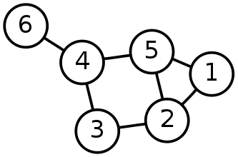
Single-Source Shortest Path Problem
Single-Source Shortest Path Problem - The problem of finding shortest paths from a source vertex v to all other vertices in the graph.

Slide 46
Dijkstra's algorithm
Dijkstra's algorithm - is a solution to the single-source shortest path problem in graph theory.
Input: Weighted graph G={E,V} and source vertex v∈V, such that all edge weights are nonnegative
Output: Lengths of shortest paths (or the shortest paths themselves) from a given source vertex v∈V to all other vertices

Slide 47
Applications of Dijkstra’s algorithm
It is used in Google maps
It is used in finding shortest path
It is used in IP routing to find the open shortest path first.
It is used in telephone networks.

Slide 48
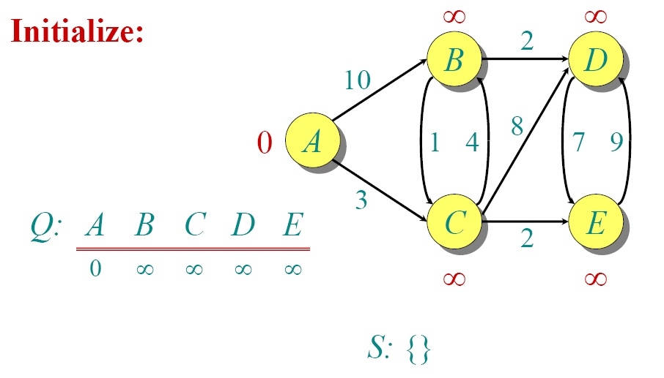
Dijkstra Animated Example

Slide 49
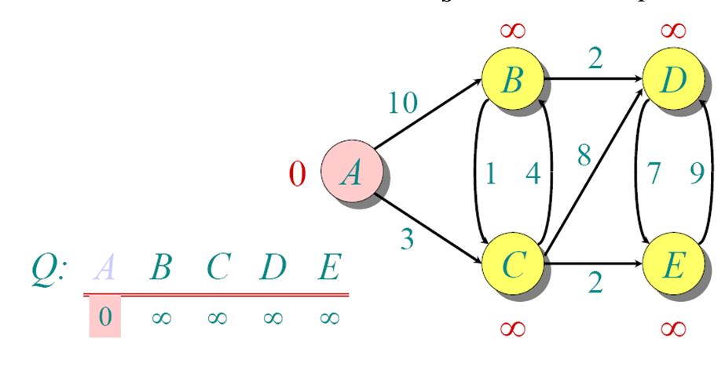
Dijkstra Animated Example

Slide 50
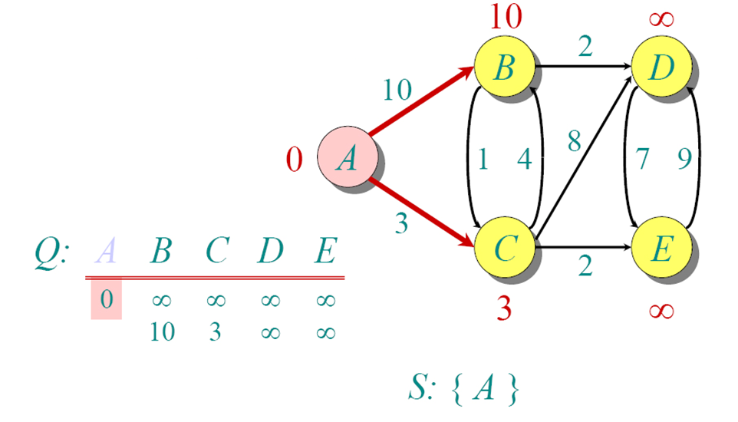
Dijkstra Animated Example

Slide 51
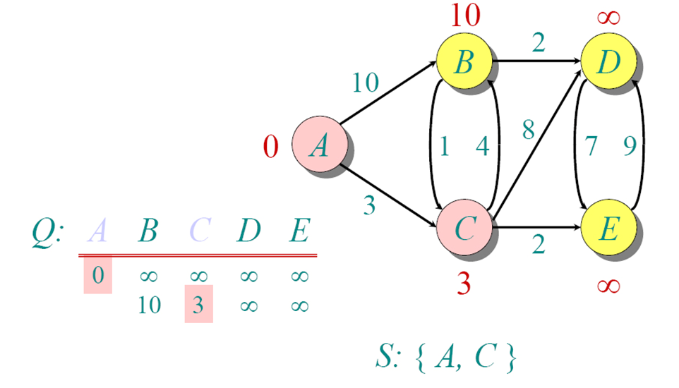
Dijkstra Animated Example

Slide 52
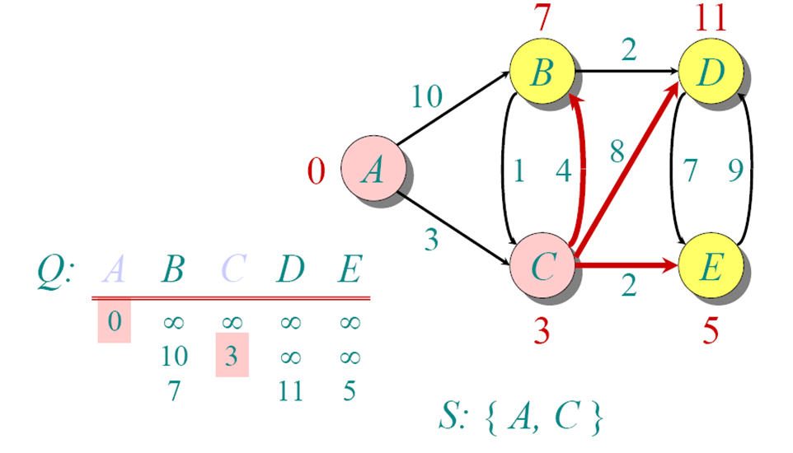
Dijkstra Animated Example

Slide 53
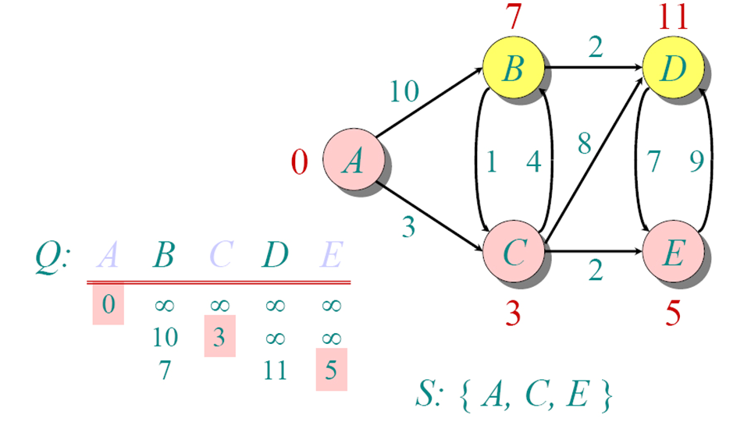
Dijkstra Animated Example

Slide 54
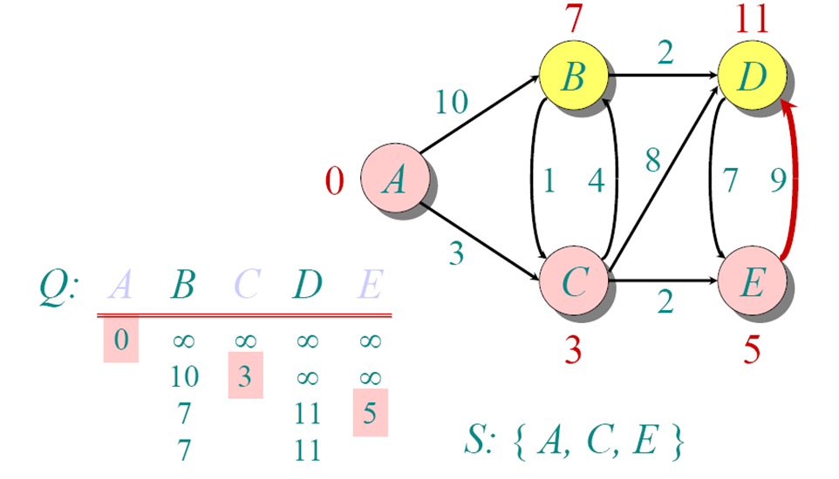
Dijkstra Animated Example

Slide 55
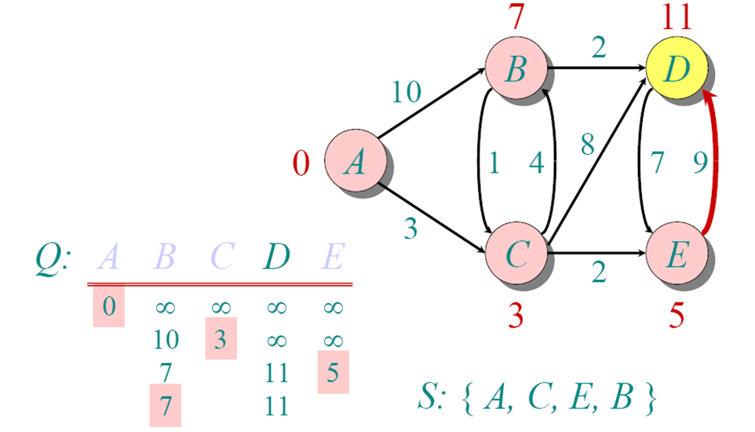
Dijkstra Animated Example

Slide 56
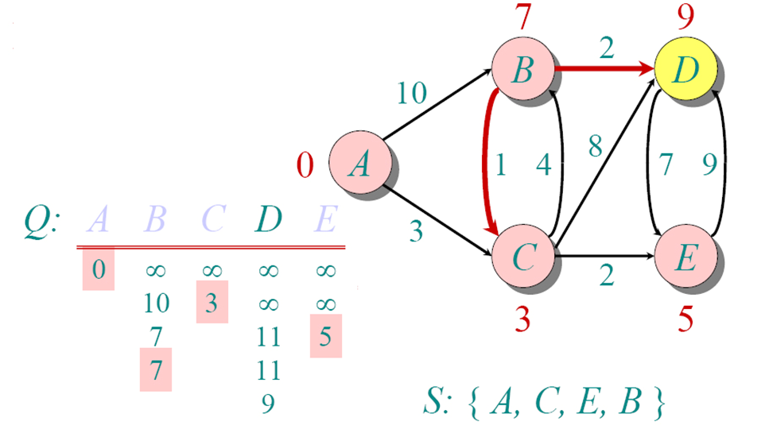
Dijkstra Animated Example

Slide 57
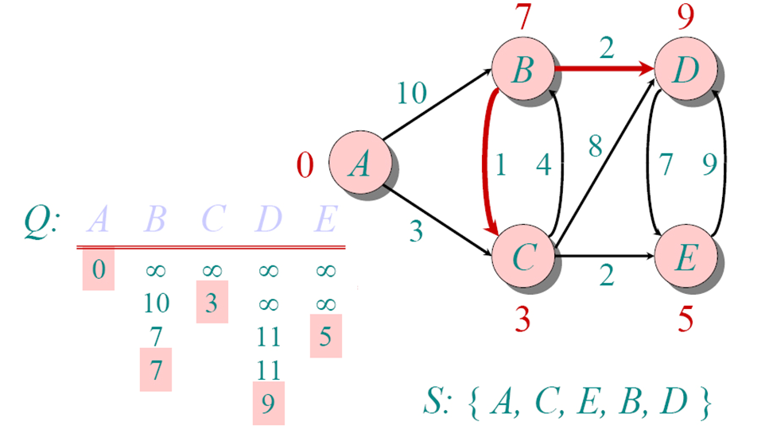
Dijkstra Animated Example

Slide 58
Dijkstra’s Algorithm
1. Select the source node also called the initial node.
2. Define an empty set S that will be used to hold nodes to which a shortest path has been found.
3. Label the initial node with 0, and insert it into S.
4. Repeat steps 5 to 7 until the destination node is in S or there are no more labeled nodes in S.
5. Consider each node that is not in S and is connected by an edge from the newly inserted node.
6. (a) If the node that is not in S has no label then set the label of the node = the label of the newly inserted node + the length of the edge.
6. (b) Else if the node that is not in S was already labeled, then set its new label = minimum (label of newly inserted vertex +length of the edge, old label)
7. Pick a node not in S that has the smallest label assigned to it and add it to S.

Slide 59
